Slide 1
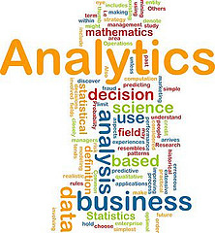
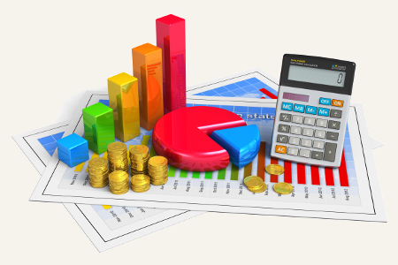
Segmentation & Cluster Analysis
Dr. Aidin Namin
BSAN 6080
Dr. Aidin Namin

Slide 2
Objectives
Provide an overview of segmentation
Discuss clustering analysis in segmentation
In-class Activity!

Slide 3


Research for Segmentation
The “S” in STP
How do we actually find the segments?
?
?
?

Slide 4
Cluster Analysis
Cluster analysis is a technique used to identify groups of ‘similar’ customers in a market (i.e., market segmentation).
If some customers are very similar to one another but different from other (groups of) customers, cluster analysis can help you identify these (multiple) segments.
Brand Loyalty
Price sensitivity

Slide 5
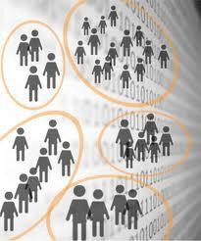
Cluster Analysis
Classifies a set of observations (usually people) into mutually exclusive groups based on combinations of variables
Members of a group should share properties
(such as attitudes and values)
Basic criterion for clustering is distance. Objects close to each other should be in the same cluster and those who are far from each other should be in different clusters

Slide 6

Applications of Cluster Analysis in Analytics
PRIZM (“Potential Ratings Index for Zip Markets”) by
Claritas
Demographic and behavioral characteristics
Available for about 48,000 residential zip codes (also for zip + 4)
66 clusters and 14 broader social groups
Recommendation system (Amazon, Netflix)
Past behavior (browse, purchase, rating, etc)

Slide 7
Prizm Data
Based on clustering of Census and other data by zip or zip + 4
Come in a file of codes by zip or zip+4, merge the file with zip measure on your database
Social codes tend to be the most useful – usually don’t have enough members of 66 clusters in dataset

Slide 8
Social Codes

Slide 9

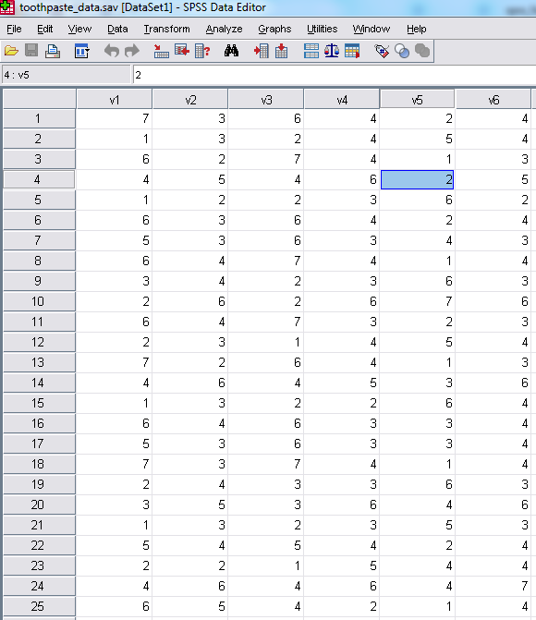
Cluster Analysis in SPSS: Toothpaste Data
Data file “toothpaste_data.sav”
6 variables, measured on a scale
from 1 to 7
30 respondents
Objective – run a Cluster Analysis to:
Identify # of clusters/segments.
Assign each customer to a cluster/segment.
Describe each cluster/segment.

Slide 10
Cluster Analysis: Number of Clusters
You first need to establish the # of clusters in the data
Best method for this purpose is Hierarchical Cluster Analysis
In analytics, Ward’s Method of Hierarchical clustering is generally most appropriate, using the Squared Euclidian distance metric to determine how far or close two individuals are in attribute space
The Dendrogram produced by Hierarchical clustering will allow you to determine the most appropriate number of clusters

Slide 11
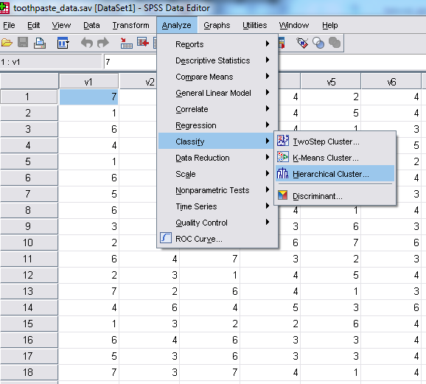
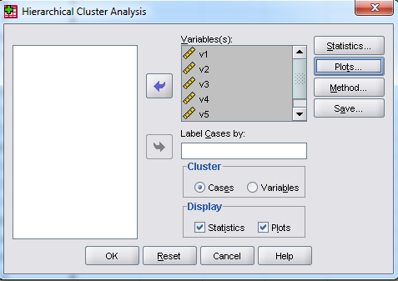
Hierarchical Cluster Analysis in SPSS
Select Analyze → Classify →
Hierarchical Cluster
MKT
Select
All the variables and Click Plots
6309

Slide 12
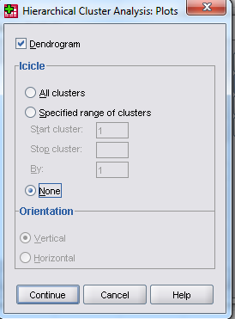
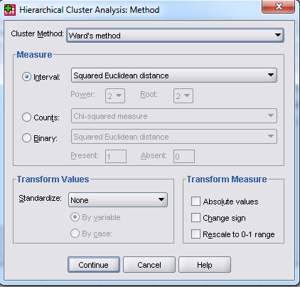
Cluster Analysis in SPSS
Next, we will use Plots and Method Menus
1. Select: “Dendrogram”
2. Select: “Ward’s Method” &
and “None” from the
Plots menu
“Squared Euclidean Distances”
in the Method menu
3. Run the Cluster Analysis by clicking OK in the main menu.

Slide 13
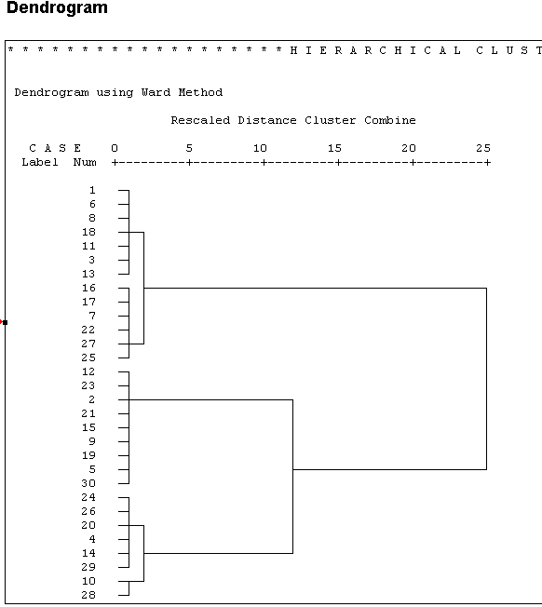
Cluster Analysis: Hierarchical
Use the Dendrogram to determine how many clusters should be extracted.
Look for a ‘jump’ along the horizontal axis. At that point 2 dissimilar clusters have been grouped together. The measure along the horizontal axis is an indicator of the level of heterogeneity within a cluster. Purpose is to create homogenous groups.
Once you decide on the # of clusters (3 here), use K-means clustering to calculate the final cluster solution.
The dendrogram
suggests 3 segments.
Here is the jump!

Slide 14
Cluster Analysis: Forming the Clusters
Once you have determined the appropriate number of
clusters to extract, use the K-means algorithm to form them
The main advantage of this algorithm is its flexibility and robustness in finding the most appropriate grouping of individuals. While Hierarchical clustering is great way to determine the number of clusters it is generally inferior to K- means in forming the actual clusters
Using Hierarchical Cluster Analysis to select the number of clusters, followed by K-means clustering to form the final clusters is the generally preferred method to cluster data in analytics

Slide 15
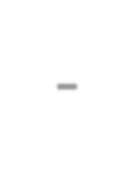
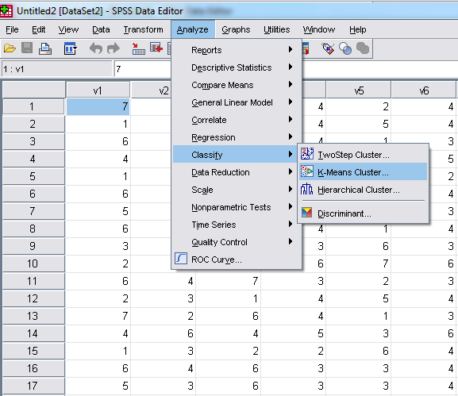
Cluster Analysis: K-Means
Select ‘K-Means’ from the
‘Classify’ menu

Slide 16
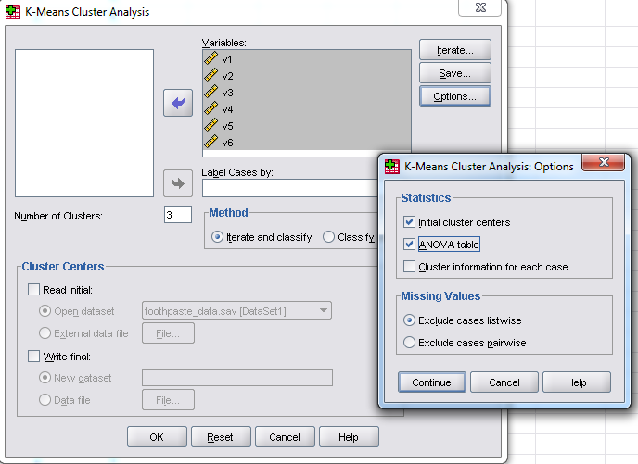
Cluster Analysis in SPSS
3. Select: Save “Cluster
Membership”.
A new variable will be created
in your data file showing who is in which cluster
(i.e., cluster membership).
1. Select
All the variables and specify the number of clusters
16
4. Run the Cluster Analysis by clicking OK in the main menu.
2. Select: “ANOVA table” in
The options menu.
This will give you an indication on which variables the clusters differ most.

Slide 17
Cluster Analysis: Interpretation
Each of the variables (V1
– V6)
seems to
discriminate between the 3 clusters. Specifically, there are ‘significant’ differences in the variable means for V1-V6 across clusters.
ANOVA
Cluster
Er ror
Number of Cases in each Cluster
 | Mean Squar e | df |  | Mean Squar e | df |  | F
V1 | 48.150 |  | 2 | .651 |  | 27 | 74.003
V2 | 19.062 |  | 2 | .614 |  | 27 | 31.047
V3 | 52.309 |  | 2 | .670 |  | 27 | 78.112
V4 | 19.700 |  | 2 | .567 |  | 27 | 34.767
V5 | 35.427 |  | 2 | 1.283 |  | 27 | 27.609
V6 | 16.714 |  | 2 | .842 |  | 27 | 19.847
Sig.
Cluster 1
2
3
8
9
13
30
.000
.000
.000
.000
.000
.000
.000
Valid Missing
The F tests should be used only f or descr iptive purposes because the clusters have been chosen to
m axim ize the differences am ong cases in diff er ent cluster s. The obser ved signif icance levels are not corrected for this and thus cannot be interpreted as tests of the hy pothesis that the cluster m eans are
equal.

Slide 18

Cluster Analysis: Interpreting the Solution
In the SPSS output we use the ‘Final Cluster Centers’ table to
describe the group of individuals assigned to a cluster
The table contains information on the average score for a variable across all members in that cluster
You generally look for values that stand out. These can be either very high or low average values! This may not be an easy process-- determining the variables to use is certainly an art!
If there are no significant differences in the average value of a variable across different clusters that variable is not useful to differentiate the segments of people
Highlight the variables that seems to most clearly distinguish the different clusters and use these to generate a label for the group that describes them and the ways in which they differ from others

Slide 19
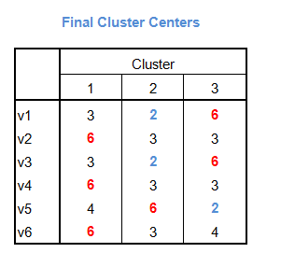
Cluster Analysis: Interpretation
V1: It is important to buy a toothpaste that prevents cavities. V2: I like a toothpaste that gives shiny teeth.
V3: A toothpaste should strengthen gums.
V4: I prefer a toothpaste that freshens breath.
V5: Prevention of tooth decay is not an important benefit offered by a toothpaste. V6: The most important consideration in buying a toothpaste is attractive teeth.
1 = disagree; 7 = agree
Number of Cases in each Cluster
Cluster 1
2
3
8
9
13
30
.000
Valid Missing
Cluster 1: Cosmetic Brushers Cluster 2: Uninvolved Brushers Cluster 3: Therapeutic Brushers

Slide 20

In-Class Activity: Shopping Attitudes (Attitudinal Data Posted on BrightSpace)
V1: Shopping is fun
V2: Shopping is bad for your budget
V3: I combine shopping with eating out V4: I try to get the best buys while
shopping
V5: I don’t care about shopping
V6: You can save a lot of money by
comparing prices
1 = strongly disagree; 7 = strongly agree
Are there segments of shoppers with similar attitudes?
How many?
Who are they?
Choose a ‘label’ for each cluster!
Write a paragraph: develop a targeting strategy for each cluster

Slide 21
Cluster Analysis: Attitudinal Data
Respondent # 1 2 | V₁ 6 2 | V₂ 4 3 | V₃ 7 1 | V₄ 3 4 | V₅ 2 5 | V₆ 3 4
3 | 7 | 2 | 6 | 4 | 1 | 3
4 | 4 | 6 | 4 | 5 | 3 | 6
5 | 1 | 3 | 2 | 2 | 6 | 4
6 | 6 | 4 | 6 | 3 | 3 | 4
7 | 5 | 3 | 6 | 3 | 3 | 4
8 | 7 | 3 | 7 | 4 | 1 | 4
9 | 2 | 4 | 3 | 3 | 6 | 3
10 | 3 | 5 | 3 | 6 | 4 | 6
11 | 1 | 3 | 2 | 3 | 5 | 3
12 | 5 | 4 | 5 | 4 | 2 | 4
13 | 2 | 2 | 1 | 5 | 4 | 4
14 | 4 | 6 | 4 | 6 | 4 | 7
15 | 6 | 5 | 4 | 2 | 1 | 4
16 | 3 | 5 | 4 | 6 | 4 | 7
17 | 4 | 4 | 7 | 2 | 2 | 5
18 | 3 | 7 | 2 | 6 | 4 | 3
19 | 4 | 6 | 3 | 7 | 2 | 7
20 | 2 | 3 | 2 | 4 | 7 | 2

